Slide 1
OpenMP
Samir Shaikh
C-DAC Pune

Slide 2
Contents
Basic Architecture
Sequential Program Execution
Introduction to OpenMP
OpenMP Programming Model
OpenMP Syntax and Execution
OpenMP Directives and Clauses
Race Condition
Environment variables
OpenMP examples
Good things and Limitation of OpenMP
References

Slide 3
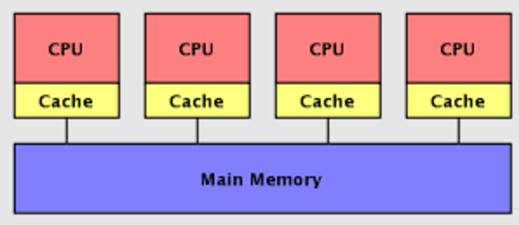
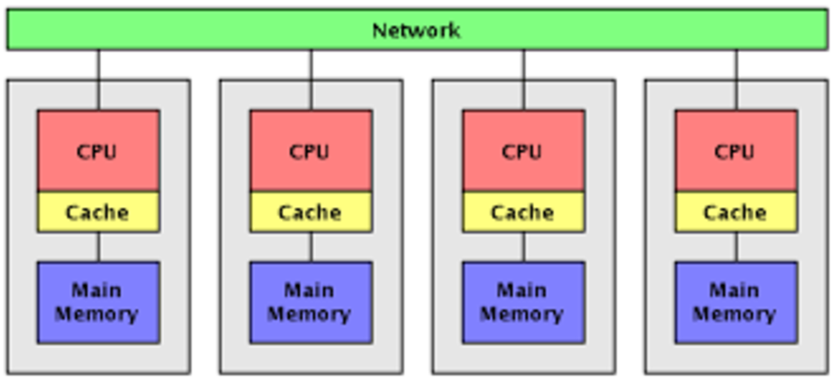
Parallel programing Architectures/Model ..
Shared-memory Model
Distributed-memory Model
openMP
Pthreads ...
MPI - Message Passing Interface
Hybrid model

Slide 4
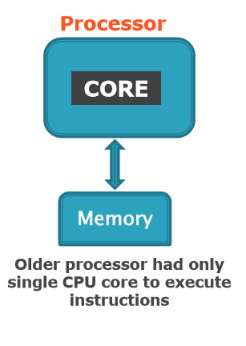
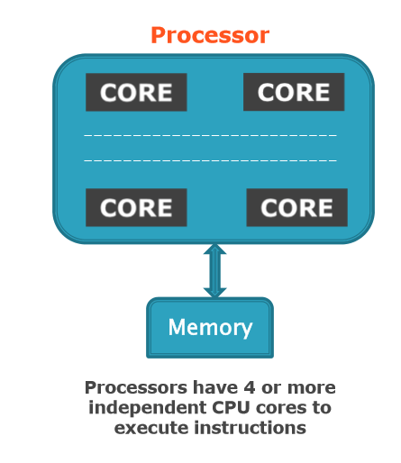
Basic Architecture

Slide 5
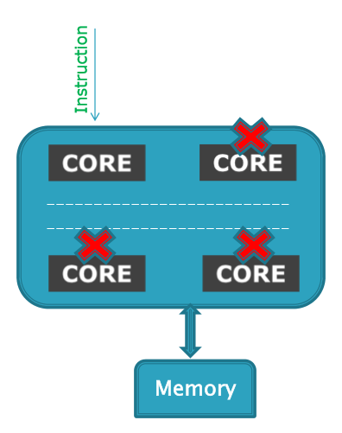
Sequential Program Execution
When you run sequential
program
Instructions executed in serial
Other cores are idle
Waste of available resource...
We want all cores to be used
to execute program.
HOW ?

Slide 6
OpenMP Introduction
Open Specification for Multi Processing.
It is an specification for
OpenMP is an Application Program Interface
(API) for writing multi-threaded, shared
memory parallelism.
Easy to create multi-threaded programs in
C,C++ and Fortran.

Slide 7
OpenMP Versions
Fortran 1.0 was released in October 1997
C/C++ 1.0 was approved in November 1998
version 2.5 joint specification in May 2005
OpenMP 3.0 API released May 2008
Version 4.0 released in July 2013
Version 4.5 released in Nov 2015

Slide 8
Why Choose OpenMP ?
Portable
standardized for shared memory architectures
Simple and Quick
Relatively easy to do parallelization for small parts of
an application at a time
Incremental parallelization
Supports both fine grained and coarse grained
parallelism
Compact API
Simple and limited set of directives
Not automatic parallelization

Slide 9
Execution Model
OpenMP program starts single threaded
To create additional threads, user starts a parallel region
additional threads are launched to create a team
original (master) thread is part of the team
threads “go away” at the end of the parallel region:
usually sleep or spin
Repeat parallel regions as necessary
Fork-join model

Slide 10
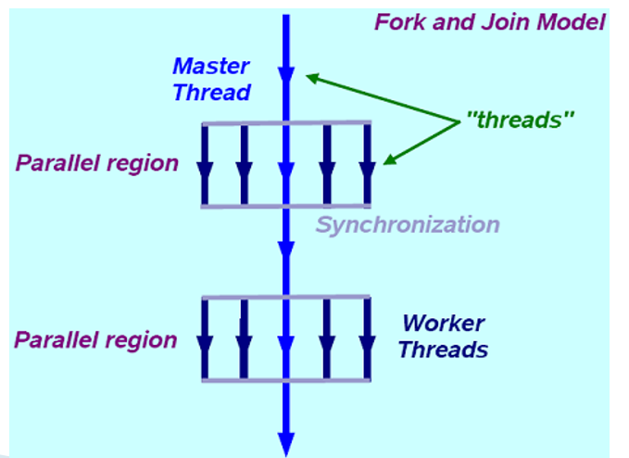
OpenMP Programming Model
main (..)
{
#pragma omp parallel
{
……
…...
}
#pragma omp parallel
{
……
…...
}
}

Slide 11
Communication Between Threads
Shared Memory Model
threads read and write shared variable no need for explicit message passing
use synchronization to protect against race conditions
change storage attributes for minimizing synchronization and improving cache reuse

Slide 12
When to use openMP ?
Target platform is multi core or
multiprocessor.
Application is cross-platform
Parallelizable loop
Last-minute optimization

Slide 13
OpenMP Basic Syntax
Header file
#include <omp.h>
Parallel region:
#pragma omp construct_name [clause, clause...]
{
// .. Do some work here
}
// end of parallel region/block
Environment variables and functions
In Fortran:
!$OMP construct [clause [clause] .. ]
C$OMP construct [clause [clause] ..]
*$OMP construct [clause [clause] ..]

Slide 14
Executing OpenMP Program
Compilation
gcc –fopenmp <program name> –o <execcutable>
gfortran –fopenmp <program name> –o <execcutable>
ifort <program name> -qopenmp –o <execcutable>
icc <program name> -qopenmp –o <execcutable>
Execution:
./ <executable-name>

Slide 15
Compiler support for OpenMP
Compiler | Flag
GNU (gcc/g++) | -fopenmp
Intel (icc) | -qopenmp
Sun | -xopenmp
Many more….

Slide 16
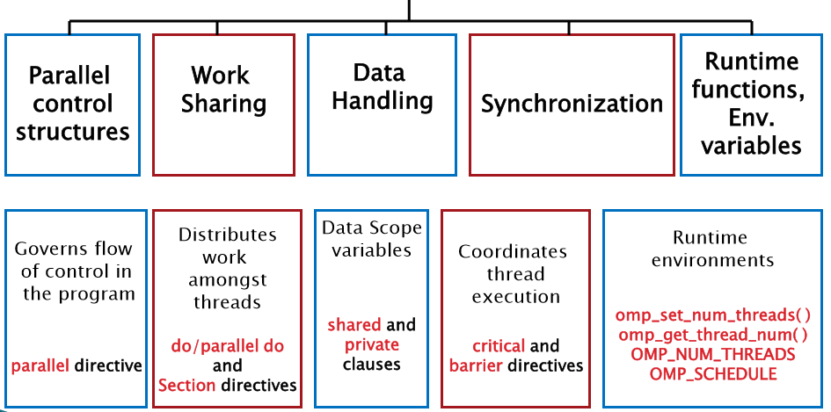
OpenMP Language extensions

Slide 17
OpenMP Constructs
Parallel Regions
#pragma omp parallel
Worksharing
#pragma omp for, #pragma omp sections
Data Environment
#pragma omp parallel shared/private (...)
Synchronization
#pragma omp barrier, #pragma omp critical

Slide 18
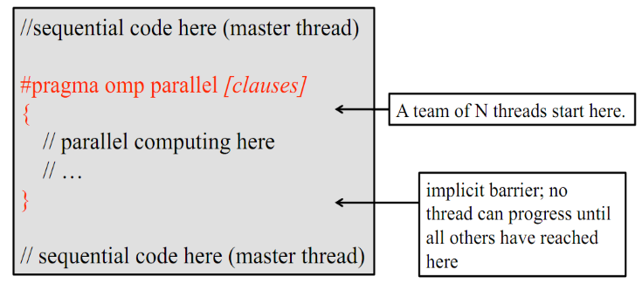
Parallel Region
Fork a team of N threads {0.... N-1}
Without it, all codes are sequential

Slide 19
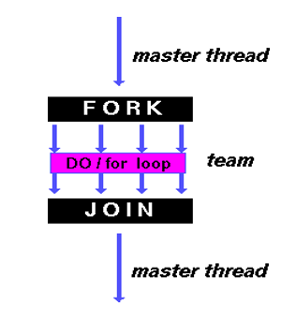
Loop Constructs: Parallel do/for
In C:
#pragma omp parallel for
for(i=0; i<n; i++)
a[i] = b[i] + c[i]
In Fortran:
!$omp parallel do
Do i=1, n
a(i) = b(i) +c(i)
enddo

Slide 20
Clauses for Parallel constructs
#pragma omp parallel [clause, clause, ...]
shared
private
firstprivate
lastprivate
nowait
if
reduction
Schedule
default

Slide 21
private Clause
The values of private data are undefined upon
entry to and exit from the specific construct.
Loop iteration variable is private by default.
Example:
#prgma omp parallel for private(a)
for(i=0; i<n; i++)
{
a=i+1;
printf(“Thread %d has value of a=%d for i=%d\n”,
omp_get_thread_num(),a,i)
}

Slide 22
firstprivate Clause
The clause combines behavior of private
clause with automatic initialization of the
variables in its list.
Example:
b=50,n=1858;
printf(“Before parallel loop: b=%d ,n=%d\n”,b,n)
#pragma omp parallel for private(i), firstprivate(b), lastprivate(a)
for(i=0; i<n; i++)
{
a=i+b;
}
c=a+b;

Slide 23
lastprivate Clause
Performs finalization of private variables.
Each thread has its own copy.
Example:
b=50,n=1858;
printf(“Before parallel loop: b=%d ,n=%d\n”,b,n)
#pragma omp parallel for private(i), firstprivate(b), lastprivate(a)
for(i=0; i<n; i++)
{
a=i+b;
}
c=a+b;

Slide 24
shared Clause
Shared among team of threads.
Each thread can modify shared variables.
Data corruption is possible when multiple threads
attempt to update the same memory location.
Data correctness is user’s responsibility.

Slide 25
default Clause
Defines the default data scope within parallel
region.
default(private | shared | none).

Slide 26
nowait Clause
#pragma omp parallel nowait
Allow threads that finish earlier to proceed
without waiting.
If specified, then threads do not synchronize
at the end of parallel loop.

Slide 27
reduction Clause
Performs a reduction on variables subject to
given operator.
#pragma omp parallel for reduction(+ : result)
for (unsigned i = 0; i < v.size(); i++)
{
result += v[i];
...

Slide 28
schedule Clause
#pragma omp parallel for schedule (type,[chunk size])
{
// ...some stuff
}
Specifies how loop iteration are divided
among team of threads.
Supported Scheduling Classes:
Static
Dynamic
Guided
runtime

Slide 29
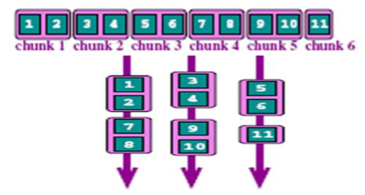
schedule Clause.. cont
schedule(static, [n])
Each thread is assigned chunks in “round robin” fashion, known as block cyclic scheduling.
If n has not been specified, it will contain CEILING(number_of_iterations / number_of_threads) iterations.
Example: loop of length 16, 3 threads, chunk size 2:

Slide 30
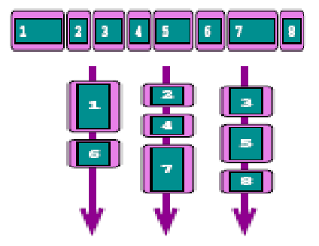
schedule Clause.. cont
schedule(dynamic, [n])
Iteration of loop are divided into chunks containing n iterations each.
Default chunk size is 1.
!$omp do schedule (dynamic)
do i=1,8
… (loop body)
end do
!$omp end do

Slide 31
schedule Clause.. cont
schedule(guided, [n])
If you specify n, that is the minimum chunk size that each thread should posses.
Size of each successive chunks is exponentially decreasing.
initial chunk size
max((num_of_iterations/num_of_threads),n)
Subsequent chunks consist of
max(remaining_iterations/number_of_threads,n) iterations.
Schedule(runtime): export OMP_SCHEDULE “STATIC, 4”
Determine the scheduling type at run time by the OMP_SCHEDULE environment variable.

Slide 32
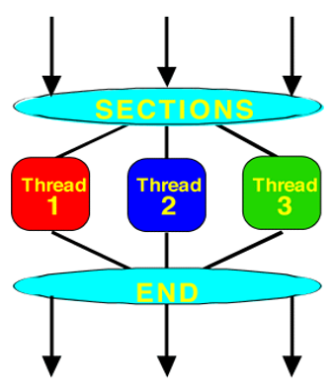
Work sharing : Section Directive
Each section is executed exactly once and one thread executes one section
#pragma omp parallel
#pragma omp sections
{
#pragma omp section
x_calculation();
#pragma omp section
y_calculation();
#pragma omp section
z_calculation();
}

Slide 33
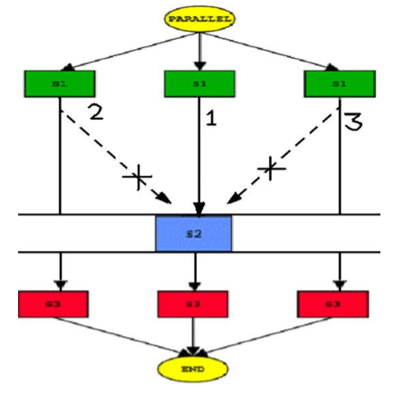
Work sharing : Single Directive
Designated section is executed by single thread only.
#pragma omp single
{
a =10;
}
#pragma omp for
{
for (i=0;i<N;i++)
b[i] = a;
}

Slide 34
Work sharing : Master
Similar to single, but code block will be executed by the master thread only.
#pragma omp master
{
a =10;
}
#pragma omp for
{
for (i=0;i<N;i++)
b[i] = a;
}
C/C++:
#pragma omp master
----- block of code--

Slide 35
Race condition
Finding the largest
element in a list of
numbers.
Max = 10
!$omp parallel do
do i=1,n
if(a(i) .gt. Max) then
Max = a(i)
endif
enddo
Thread 0
Read a(i) value = 12
Read Max value = 10
If (a(i) > Max) (12 > 10)
Max = a(i) (i.e. 12)
Thread 1
Read a(i) value = 11
Read Max value = 10
If (a(i) > Max) (11 > 10)
Max = a(i) (i.e. 11

Slide 36
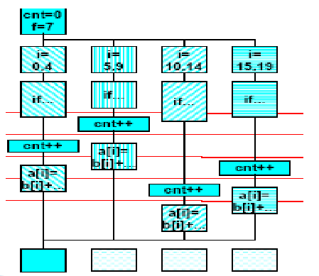
Synchronization: Critical Section
Directive restrict access to the enclosed code to only one thread at a
time.
cnt = 0, f=7;
#pragma omp parallel
{
#pragma omp for
for(i=0;i<20;i++)
{
if(b[i] == 0)
{
#pragma omp critical
cnt++;
}
a[i] = b[i] + f*(i+1);
}
}

Slide 37
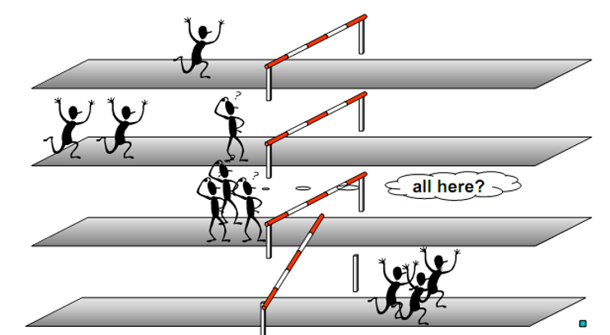
Synchronization:Barrier Directive
Synchronizes all the threads in a team.

Slide 38
Synchronization:Barrier Directive
int x=2;
#pragma omp parallel shared(x)
{
int tid = omp_get_thread_num(); if(tid == 0)
x=5;
else
printf(“[1] thread %2d:
x=%d\n”,tid,x);
#pragma omp barrier printf(“[2] thread %2d:
x=%d\n”,tid,x);
}
Some threads may still have x=2 here
Cache flush + thread synchronization
All threads have x=5 here

Slide 39
Synchronization:Atomic Directive
Mini Critical section.
Specific memory location must be updated atomically.
C:
#pragma omp atomic
----- Single line code--

Slide 40
Environment Variable
To set number of threads during execution
export OMP_NUM_THREADS=4
To allow run time system to determine the number of threads
export OMP_DYNAMIC=TRUE
To allow nesting of parallel region
export OMP_NESTED=TRUE
Get thread ID
omp_get_thread_num()

Slide 41
Control the Number of Threads
Parallel region
#pragma omp parallel num_threads(integer)
Run-time function/ICV
omp_set_num_threads(integer)
Environment Variable
OMP_NUM_THREADS
Higher Priority

Slide 42
Good Things about OpenMP
Incrementally Parallelization of sequential code.
Leave thread management to compiler.
Directly supported by compiler.

Slide 43
Limitations
Internal details are hidden
Run efficiently in shared-memory multiprocessor platforms only but not on distributed memory
Limited performance by memory architecture

Slide 44
References
https://computing.llnl.gov/tutorials/openMP/
http://wiki.scinethpc.ca/wiki/images/9/9b/D s-openmp.pdf
www.openmp.org/
http://openmp.org/sc13/OpenMP4.0_Intro_Y onghongYan_SC13.pdf

Slide 45
Thank You

Slide 46
Task Construct
Tasks in OpenMP are code blocks that the compiler wraps up and makes available to be executed in parallel.
int fib(int n)
{
int i, j;
if (n<2) return n;
else
{
#pragma omp task shared(i) firstprivate(n)
i=fib(n-1);
#pragma omp task shared(j) firstprivate(n)
j=fib(n-2);
#pragma omp taskwait
return i+j;
}
}

Slide 47
Task Construct
1. Taskgroup Construct
#pragma omp taskgroup
2.Taskloop Construct
#pragma omp taskloop num_tasks (x)
3.Taskyield Construct
#pragma omp taskyield
4.Taskwait Construct
#pragma omp taskwait
5. Task dependency
#pragma omp task depend(in: x)
6.Task priority
#pragma omp task priority(1)

Slide 48
Taskloop Construct
OpenMP 4.0
OpenMP 4.5
#pragma omp taskgroup { for (int tmp = 0; tmp < 32; tmp++) #pragma omp task for (long l = tmp * 32; l < tmp * 32 + 32; l++) do_something (l); }
#pragma omp taskloop num_tasks (32) for (long l = 0; l < 1024; l++) do_something (l);

Slide 49
OpenMP 4.5 Features
Explicit map clause
• Target Construct
• Target data Construct
• Target Update Construct
• Declare target
• Teams construct
• Device run time routines
• Target Memory and device pointer routines
• Thread Affinity
• Linear clause in loop construct
• Asynchronous target execution with nowait clause
• Doacross loop construct
SIMD construct

Slide 50
Environment Variable
To set number of threads during execution
export OMP_NUM_THREADS=4
To allow run time system to determine the number of threads
export OMP_DYNAMIC=TRUE
To allow nesting of parallel region
export OMP_NESTED=TRUE
Get thread ID
omp_get_thread_num()

Slide 51
Control the Number of Threads
Parallel region
#pragma omp parallel num_threads(integer)
Run-time function/ICV
omp_set_num_threads(integer)
Environment Variable
OMP_NUM_THREADS
Higher Priority

Slide 52
OPENMP 3.1 TO 4+ FEATURES
Openmp 3.0 | Openmp 4.0 to 4.0.2 | Openmp 4.0.2 to 4.5
Parallel construct Worksharing construct Synronization construct Data sharing clauses Task Construct | Proc_bind clause Task group construct Task dependences Target construct Target update construct Declare target construct Teams construct Device runtime routines Distribute construct | Task Priority Task loop construct Device memory routines and device pointers Do across loop construct Linear clause in loop construct Cancellation Construct

Slide 53
Good Things about OpenMP
Incrementally Parallelization of sequential code.
Leave thread management to compiler.
Directly supported by compiler.

Slide 54
Limitations
Internal details are hidden
Run efficiently in shared-memory multiprocessor platforms only but not on distributed memory
Limited performance by memory architecture

Slide 55
References
https://computing.llnl.gov/tutorials/openMP/
http://wiki.scinethpc.ca/wiki/images/9/9b/D s-openmp.pdf
www.openmp.org/
http://openmp.org/sc13/OpenMP4.0_Intro_Y onghongYan_SC13.pdf

Slide 56
References
https://www.openmp.org/#
https://www.openmp.org/resources/openmp-benchmarks/
https://www.openmp.org/resources/openmp-presentations/
https://www.openmp.org/resources/openmp-presentations/sc-19-booth-talks/
https://www.openmp.org/events/sc21/

Slide 57
Thank You

